Slide 1

UCL CENTRE FOR ADVANCED SPATIAL ANALYSIS
THE BARTLETT
UCL CENTRE FOR ADVANCED SPATIAL ANALYSIS
THE BARTLETT
UCL CENTRE FOR ADVANCED SPATIAL ANALYSIS
THE BARTLETT
Applied Urban Modelling Conference
Cambridge
1 – 3 April 2014
The Effect of Transport on Rent in the Polycentric City
Robin Morphet
r.morphet@ucl.ac.uk
Show the link between von Thunen Rent and the Spatial Interaction Model
Examine the effect of rent change on the assessment of schemes
Explore relation of polycentric rent to the economics of agglomeration
Notes:
The link is that the von Thunen rent is embedded in the algebraic formulation of the maximum entropy transportation model. Every distribution model with the
The model requires some empirical verification which we carry out for London and its surrounding metropolitan area
The relation of the model to agglomeration is the area on which I am working now
However

Slide 2
UCL CENTRE FOR ADVANCED SPATIAL ANALYSIS
THE BARTLETT
Modelling v Economics
‘regional scientists and geographers have developed several models, ranging from the entropy (Wilson, 1967) to the gravity and logit models(Anas, 1983) which has proven to be very effective in predicting different types of flows. By ignoring for a long time this body of research, spatial economists have missed a fundamental ingredient of the space-economy.’
(Fujita and Thisse, 2013, p256)
‘it seems unlikely that we will see technological convergence between the economic geographers and the geographical economists any time soon’
(Overman 2004)
‘In spatial interaction models there is no ..... statement about prices of any of the commodities, not even of land’
(Barra, 1989)
‘Could the entropy approach deal with price (especially land-rent) distributions as well as with physical allocations? Partial answers to these questions were provided by Senior and Wilson (1974), Anas (1973), and others, but urban economics was on a track of its own and showed signs of maturing independently. The uneasy fit between entropy models and economic models still remains, but I hope that some of this tension will be relaxed...’
(Anas, 1984)
‘Bid rent theory … serves as a framework for pencil-and-paper theoretical models, but the econometric estimation and large scale policy application of these models has proved to be difficult, unmanageable, and frustrating. In part because of this, the applied fields of transportation planning and urban modeling – which stand to benefit from urban economics – have remained largely separate from it.’
(Anas 1982)
Notes:
One of my hopes is that this work will draw closer the work of regional scientists and spatial economists
This list of quotes shows this to be a long standing problem at the heart of which lies the apparent failure of distribution models to deal with rent allocation as well as physical distribution.
However, Anas did show the formal equivalence of random utility and maximum entropy methods.
Without this rapprochemont the economists will have to argue policy with their spatially limited models whilst the urban modellers will have to argue on the basis of large models which policy makers may find difficulty engaging with.

Slide 3
UCL CENTRE FOR ADVANCED SPATIAL ANALYSIS
THE BARTLETT
Aims
von Thünen
Laplace
Lagrange
Legendre
Boltzman
Helmholtz
Gibbs
Jaynes
land use
Lösch
Lowry
location
spatial interaction
Launhardt, Weber, Christaller
Reilly, Tobler, Wilson
Notes:
However, reverting back to urban modelling
This slide shows that one of the purposes in looking at this issue is to plug a gap in traditional land use/ location theory
Namely the presence of rent in the von Thunen model but not in spatial interaction
We will also show a link to location theory

Slide 4
UCL CENTRE FOR ADVANCED SPATIAL ANALYSIS
THE BARTLETT
Describe von Thunen construction
Show relation to Legendre transform
Maximum entropy derivation of the von Thunen model
Identify the maximum entropy model’s Legendre transform and hence its rent parameter
Extend to doubly constrained model
Examine potential uses and interpretation in
the context of complexity
Examine empirical case study
The point to emphasise is that in any entropy maximising transportation
model the von Thunen land rent is automatically calculated
Notes:
The new concepts introduced are
The linearisation of von Thunen’s bid rent curve
Its analysis as a Legendre transform
The derivation of von Thunen through entropy maximisation
The identification of the rent parameter in the maximum entropy model

Slide 5
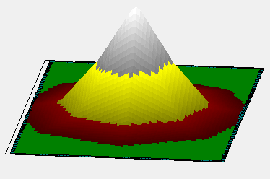
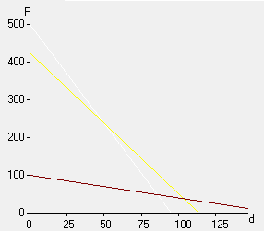
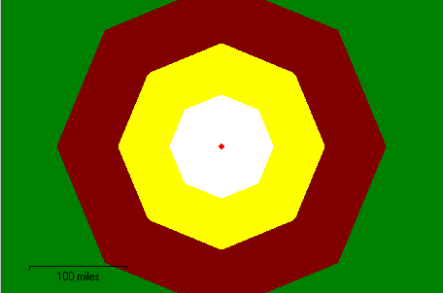
UCL CENTRE FOR ADVANCED SPATIAL ANALYSIS
THE BARTLETT
The von Thunen Model
Trip costs determine rents
Rents determine land use
Steadman, P., Von Thunen Model, http://www.bartlett.ucl.ac.uk/casa/latest/software/the-von-thunen-model
Centre for Advanced Spatial Analysis, 2008
Notes:
This slide is taken from Philip Steadman’s von Thunen visualisation (available on the CASA web site).
It shows how starting with trip costs for particular activities we determine a bid rent envelope which in turn determines the distribution of land for those activities.
In this case the white refers to milk, the yellow to grain and the reddish brown to livestock.
For a single city we see the cone of the rent surface and the concentric ring structure of the land uses.

Slide 6
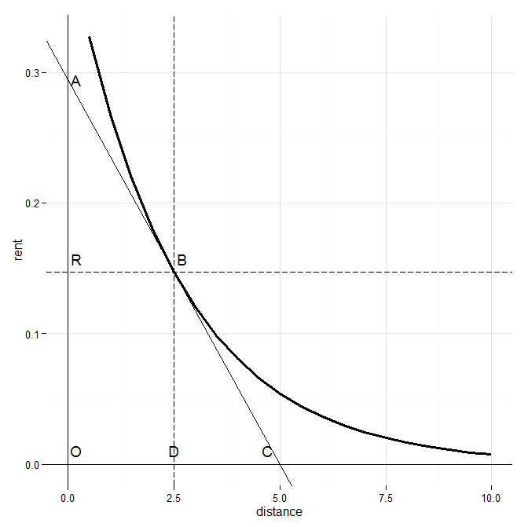
UCL CENTRE FOR ADVANCED SPATIAL ANALYSIS
THE BARTLETT
Notes:
The standard von Thunen construction
OR is rent
OD is distance from the centre
The slope at B gives the cost of transport per mile at that point
AR, assuming linearity, gives the total cost of a trip from B

Slide 7
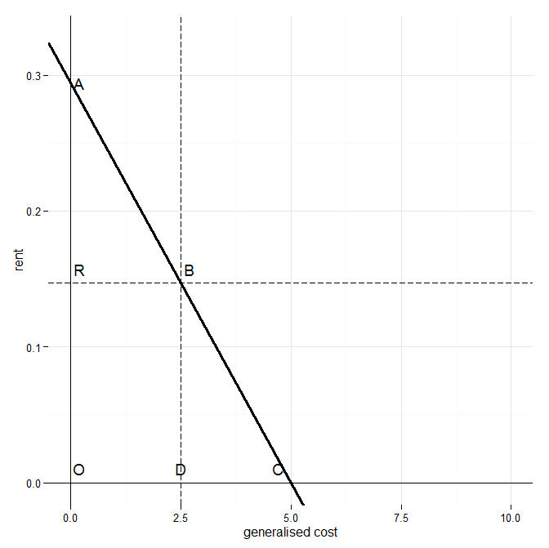
UCL CENTRE FOR ADVANCED SPATIAL ANALYSIS
THE BARTLETT
Notes:
The use of generalised cost rather than distance means that
OD = AR
Similarly we see that
OC = OA
The maximum rent (at zero distance) = OA
The maximum distance (at zero rent)=OC
The slope of the curve is -1

Slide 8

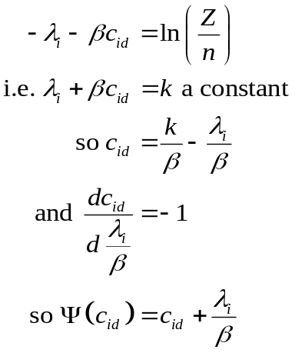



UCL CENTRE FOR ADVANCED SPATIAL ANALYSIS
THE BARTLETT
The Entropy Maximising Derivation of von Thunen
 | The City
O₁ | d_{1d}
O₂ | d_{2d}
... | ...
O_{i} | d_{id}
... | ...
O_{n} | d_{nd}
 | The City
O₁ | c_{1d}
O₂ | c_{2d}
... | ...
O_{i} | c_{id}
... | ...
O_{n} | c_{nd}
 | The City
1/n | p_{1d}
1/n | p_{2d}
... | ...
1/n | p_{id}
... | ...
1/n | p_{nd}
 | The City
1/n
1/n
... | ...
1/n
... | ...
1/n
von Thunen
model
von Thunen +
generalised cost
Assuming trips
unknown
MaxEnt
probability
estimates
The Legendre
transform
Notes:
This slide is the crux of the argument so I will spend a little longer on it.
The von Thunen model is deterministic with n zones. The entropy maximising model is probabalistic. So we set up the von Thunen model and inject uncertainty, estimate the model structure and then remove the uncertainty after which we derive the Legendre transform of cost.
In column 1 we have the zones corresponding to the rings at distance d_{id} from the city. We have unspecified origins but with only one destination we know that all the Origins at i =the trips from i to d.
In column 2 the distances change to generalised cost
In column 3 we arbitrarily assign the the number of origins but assume the number of trips is unknown
This is now set up as an Origin constrained single destination model which is shown in column 4 giving us estimates of p_{id} but we know p_{id}= O_{i} so we can remove the uncertainty

Slide 9




UCL CENTRE FOR ADVANCED SPATIAL ANALYSIS
THE BARTLETT
The Doubly Constrained Transportation Model
origin and destination
constraints
entropy
average cost
normalisation
This equation is dimensionless:
converts cost to information
It gives
which is the spatial interaction model ( in slightly unfamiliar form)
Destination rent
Origin rent:
Notes:
In this slide we extend the analysis to the doubly constrained model
The set up of the Lagrange multiplier method is shown at the top
The equation is dimensionless and the preservation of dimensional consistency is one of the themes of this work. Its a good check on the algebra.
The rent terms are as before and we see that the rent expression has dimensions of generalised cost
Just to show the consistency between this model and the classical gas model we derive the expression for Gibbs free energy from the spatial interaction model
The Gibbs free energy corresponds to the logsum of cost in random utility theory.

Slide 10






UCL CENTRE FOR ADVANCED SPATIAL ANALYSIS
THE BARTLETT
Level | Model | Effective Distance | Rent | Economy
1 | Von Thunen |  |  | Perfect competition
2 | Singly(origin) constrained |  |  | Monopolistic competition
3 | Doubly constrained |  |  | Monopolistic competition
Notes:
For case 1 free energy = trip cost +rent=enthalpy
For case 2 free energy = (cost-entropy cost ) + origin rent = Helmholtz free energy + origin rent
For case 3 free energy = (cost-entropy cost ) +rent = Gibbs free energy
Starret’s Impossibility Theorem ensures that perfect competition is impossible in polycentric space. With von Thunen it is only possible because the centre is predefined.
However monopolistic competition is the structure on which returns to scale are built in a spatial economy

Slide 11
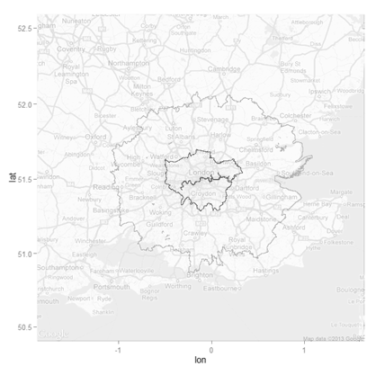
UCL CENTRE FOR ADVANCED SPATIAL ANALYSIS
THE BARTLETT
Arcadia Study Area:
London and the
Outer Metropolitan Area
Notes:
We now look at the area used for study
1767 Zones with 13.4M population
633 in London with 7.2M population
Data from travel to work tables of 1971 Census
Wards as zones
Put together by the Arcadia project

Slide 12
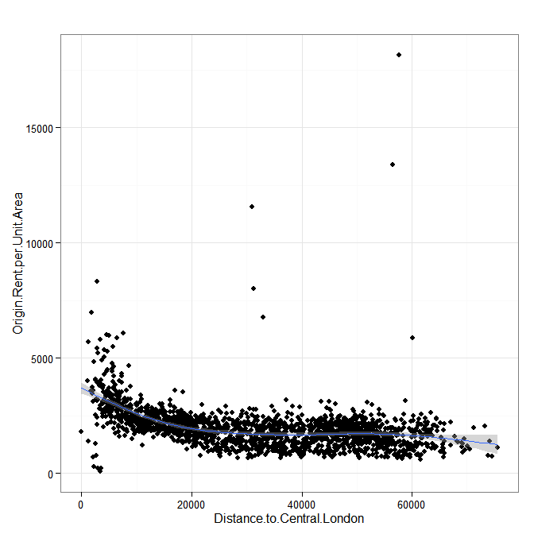
UCL CENTRE FOR ADVANCED SPATIAL ANALYSIS
THE BARTLETT
Notes:
This shows the plot of residential land rent/unit area against distance to Charing Cross
The outliers are caused by institutional populations residing in zones adjoining their institution (Universities and Hospitals). They could be treated as outliers or they could be seen to be highly subsidised locations
Otherwise a drop off of rent with distance arises as might be expected

Slide 13
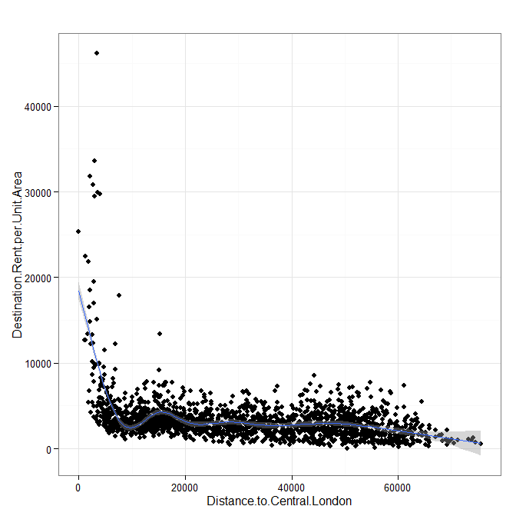
UCL CENTRE FOR ADVANCED SPATIAL ANALYSIS
THE BARTLETT
Notes:
This shows destination rent against distance
The steep rise towards the centre of London is apparent but there are also provincial centres apparent

Slide 14
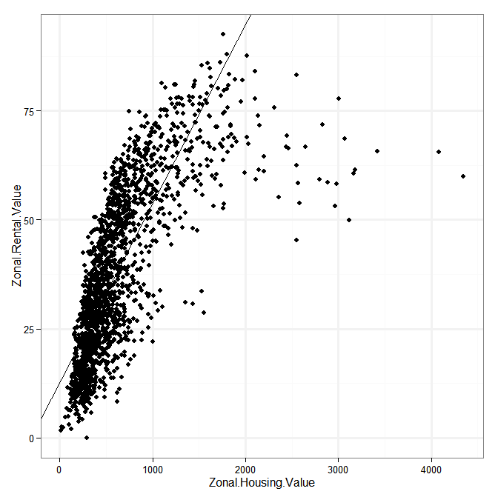
UCL CENTRE FOR ADVANCED SPATIAL ANALYSIS
THE BARTLETT
Notes:
This shows a regression of Origin zone rent values against house prices. A perfectly linear relationship would not be expected because housing values will vary with the number of storeys of the house.
In this regression values over 2000 are excluded. This removes some of the outliers and also the areas of exceptional environmental and access quality (e.g. around Regents Park)
Some of the leftmost subjects in this regression will reflect tulip mania in house prices where housing is used as a store of value ( a residential deposit box)
Rsquared = 0.6ish
Better fit than we get with overall model
Although Rsquared not such a good indicator

Slide 15

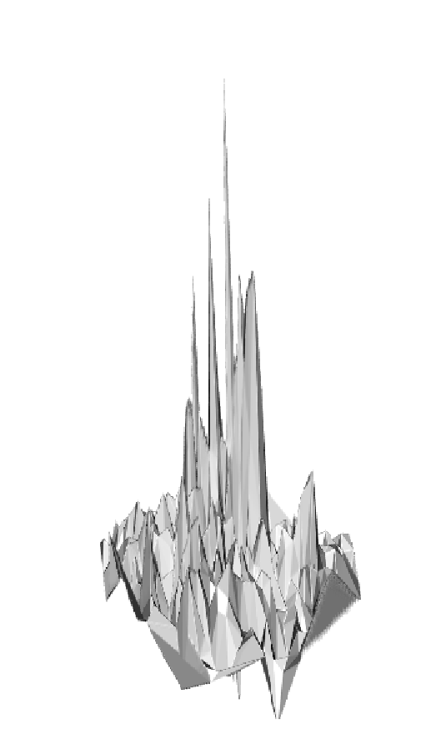
UCL CENTRE FOR ADVANCED SPATIAL ANALYSIS
THE BARTLETT
Notes:
In this slide we have a 3D plot of
Destination Rent per unit area;Wider Study Area from South (left)
Greater London Residential Rents from the South (right)
Each zone was divided into an average of 500 grid squares
Shows the polycentric structure dominated by London
Shows the ridge of high house values streching into SW London as well as high central values.

Slide 16
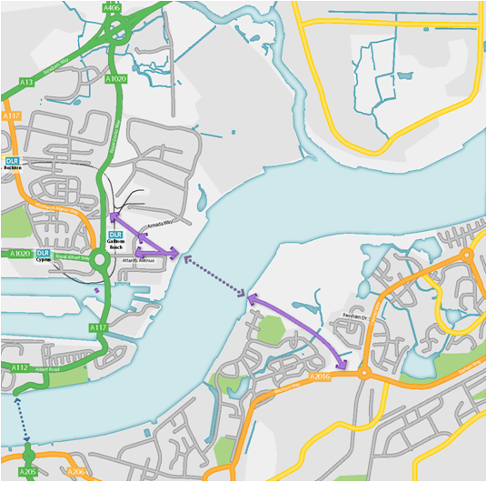
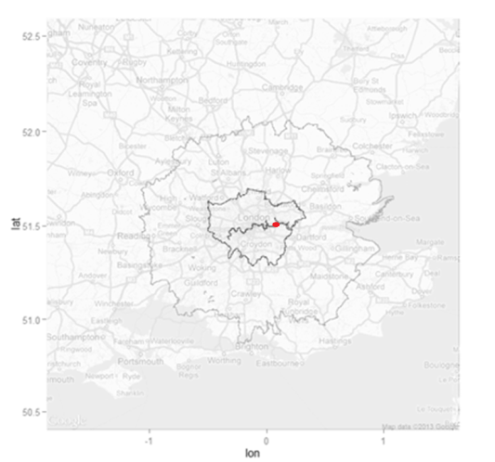
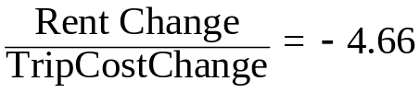
The Gallions Reach Crossing
“there are significant gains from urban transport improvements, over and above those that would be contained in a standard cost-benefit appraisal”
(Venables, 2004)
logsum consumer surplus =6557
Rule of half consumer surplus=5714
Notes:
Gallions Reach is a proposed river crossing location (bridge or ferry)
I am not arguing for or against its construction rather it is an area where change might realistically be expected.
My interest is in the significance of changes in land rent against changes in trip cost
As might be expected when trip costs decrease rents increase. However they increase disproportionately. This confirms Venables view.
The precise way in which they might be included in a cost benefit analysis is open.
The logsum and rule of ½ values of consumer surplus are quite close (rule of ½ seems conservatively safe)
It should be emphasised that rent increases are seen as increases in welfare. They are economic rents (see Mishan) but this takes no account of distributional issues.

Slide 17


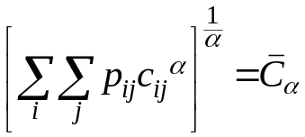

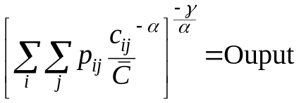
UCL CENTRE FOR ADVANCED SPATIAL ANALYSIS
THE BARTLETT
Agglomeration: Returns to Scale
Conventional mean cost constraint
Generalised mean cost constraint
CES Production function with
Conventional scale returns
Notes:
This slide picks up on work in progress
The conventional mean cost constraint gives rise to the familiar exponential cost model
However the mean is one of many so we write the constraint as a generalised mean.
α=1 is arithmetic mean
α=0 is geometric mean
α=-1 is harmonic mean
But α need not be an integer
In this form it can also be recognised as a type of production function although the more normal form (with scale parameter γ) is shown in the third equation.
However, γ destroys dimensional consistency without a numeraire hence the division by average cost.
But the middle form shows returns to scale with the growth in trips (Ethier) provided
α >1
Unfortunately calibration suggests α=1
Work goes on

Slide 18
UCL CENTRE FOR ADVANCED SPATIAL ANALYSIS
THE BARTLETT
Notes:
Finally, reverting to our 3D representation we see the fractal polycentricity of the rent surface
However, looking at it from above .............

Slide 19
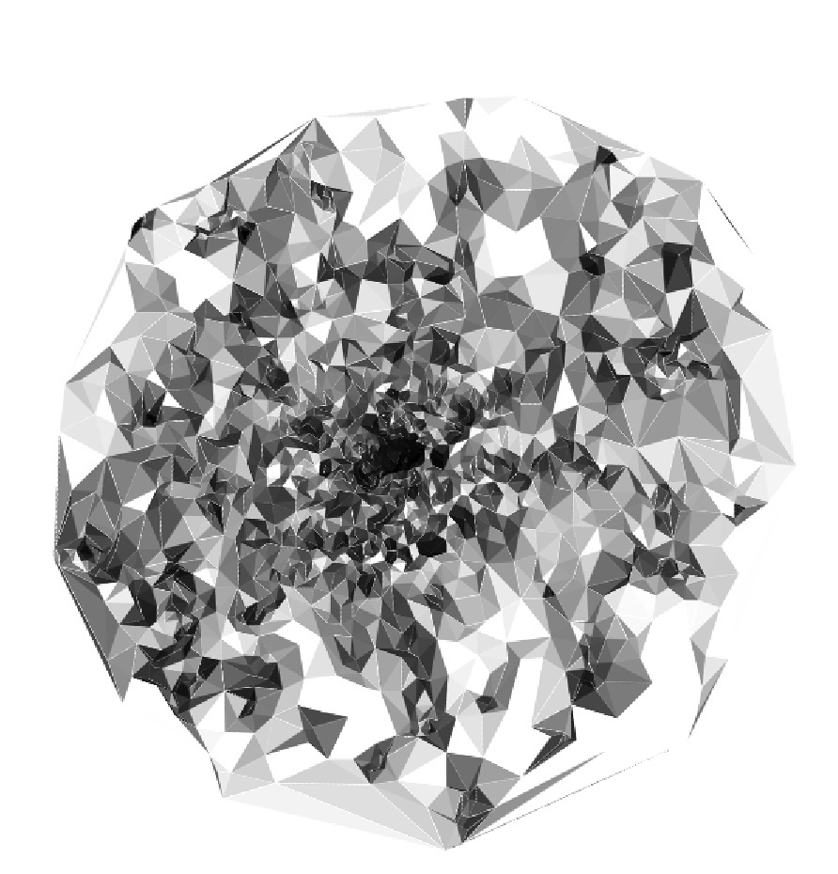

UCL CENTRE FOR ADVANCED SPATIAL ANALYSIS
THE BARTLETT
Notes:
We see the regular polygons of Christaller and Losch caused by the intersection of Launhardt cones.

